Slide 1
Local Control Accountability Plan Committee Meeting
November 26, 2018
Notes:
Good evening!

Slide 2
Agenda
Welcome and Introductions
Review district progress on LCAP metrics
District survey for input on budget reductions
In depth review of high school graduation data
Questions and feedback from the group

Slide 3
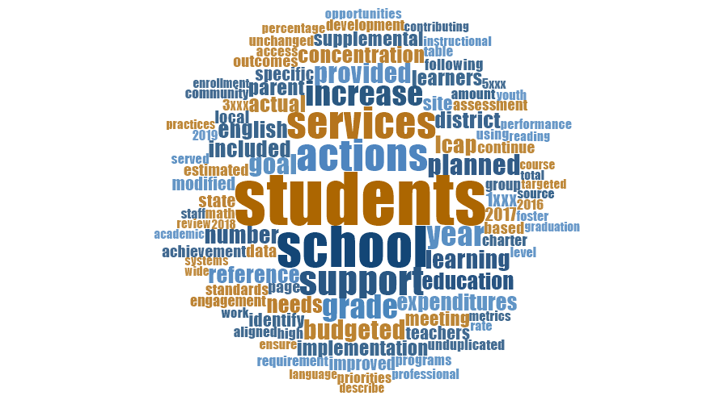

Slide 4
Review Progress on Metrics
Start with Goal 1
Review the Metrics Updates for November 2018. Notice where the district has made progress and where the district is still working on meeting the goal.
Share your noticings with your group.
What questions would you ask based on this data?

Slide 5
District Survey
Notes:
Seek to understand

Slide 6
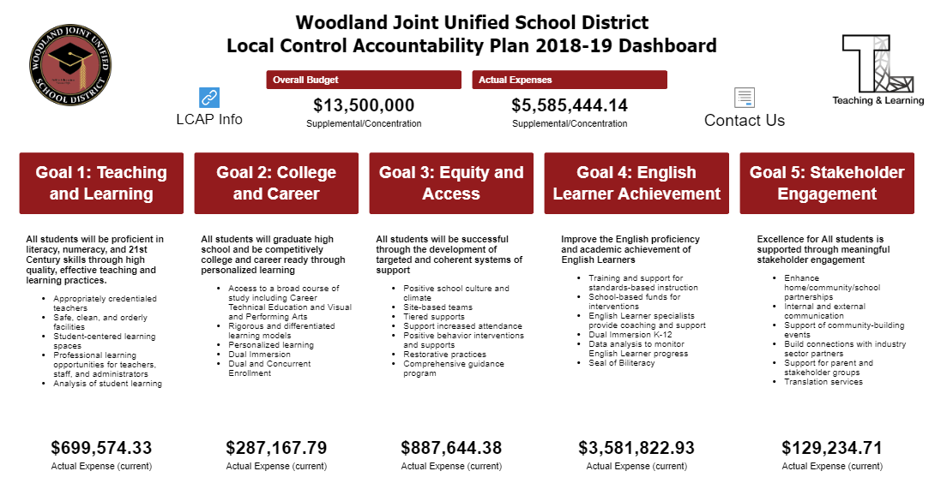

Slide 7
High School Graduation Rate – a key metric
What does the graduation rate measure?
Students who graduate on time with a high school diploma
= in 4 years
Notes:
Refer to the CDE’s flyer on the College and Career Indicator
Give two minutes for participants to review

Slide 8
What actions and services support students graduating on time?
This Photo by Unknown Author is licensed under CC BY-NC-ND

Slide 9
What actions and services support students graduating on time?
PUENTE
AVID
Credit Recovery Programs
Ethnic studies PD
Career Technical Education
College and Career Planning
Notes:
Refer to the CDE’s flyer on the College and Career Indicator
Give two minutes for participants to review

Slide 10
How do we support High School Graduation in the LCAP?*
AVID training and support
California Colleges Guidance Initiative
Credit Recovery
Software Program
Summer School
CTE Sections
Ethnic Studies
PUENTE Counselors
PUENTE support
* Not including additional services, personnel, and supports provided by the high schools

Slide 11
How do we support High School Graduation in the LCAP?*
AVID training and support - $120,000
California Colleges Guidance Initiative - $8,000
Credit Recovery
Software Program - $60,000
Summer School - $133,000
CTE Sections - $250,000
Ethnic Studies PD - $78,000
PUENTE Counselors - $190,000
PUENTE support - $9,200
TOTAL = $848,200
* Not including additional services, personnel, and supports provided by the high schools

Slide 12
What are the desired outcomes for these actions?
Increasing graduation rates
Increase in # of students on track toward graduation
Low course failure rates
High completion rates for summer courses
Lower dropout rates
More students enrolling in college after graduation

Slide 13
Evidence of Success
Questions to ask about the data…
Which students are succeeding?
Which students are not succeeding?
What are our next steps?

Slide 14
Questions and Comments

